Slide 1
Communicating Strategically About Public Charge
An introduction to media advocacy & storytelling
Notes:
INTRO
Welcome everyone and in your own words and describe why it is important that everyone is joining you for this training. How does it align with your organization’s or coalition’s mission or goals? Why is it important that people in the room be prepared to communicate effectively about the public charge rule?
Introduce topic and speakers
Depending on the audience, you may want to give some background on what the public charge rule is and what the proposed changes are. The other modules may have helpful information to include, especially if you are using this module on its own.
NOTE TO FACILITATORS: If you are using this module in conjunction with the Storytelling Module, we recommend starting with this module. There are some duplicate slides, as this content is also important for storytelling. If you use this module first, you can move quickly through the duplicative slides in the Storytelling Modules.

Slide 2
Research on news coverage of public health issues
Media advocacy training and strategic consultation for community groups and public health advocates
Professional education for journalists
Notes:
OVERVIEW OF BERKELEY MEDIA STUDIES GROUP, the group that created the module
This module was created by Berkeley Media Studies Group (BMSG), a nonprofit organization dedicated to expanding advocates’ ability to improve the systems and structures that determine health through research and training for public health advocates and journalists.
BMSG staff have been working with public health advocates to communicate effectively about the proposed changes to the public charge rule and the potential impact on health and welcome this opportunity to share these slides. BMSG asks that if anyone uses these slides, that they keep the BMSG logo on all slides.

Slide 3
Training objectives
Clarify your overall and media strategies and develop strategic messages for advocacy
Use language that supports your strategies on the public charge rule
Clarify why and how we can effectively use stories
Describe concerns and considerations for collecting and sharing stories
Notes:
TRAINING OBJECTIVES
This module is a VERY QUICK overview of two important parts of addressing the proposed public charge rule:
1) an introduction to media advocacy. This includes tools, such as developing an overall strategy and strategic messages, that are helpful in any form of communication, even if you are not communicating directly to the media. This module will also help you think strategically about if and how you use the media to advance your work on the public charge rule.
2) an overview of 8 tips on communicating more effectively about the proposed public charge rule. The language we use matters and there are some ways we can collectively be more effective in communicating about the public charge rule.
This module also covers how we can use storytelling to advance our work around public charge and immigration policy, looking at:
Why are you using stories? We will clarify why and how we can effectively use stories. We call this the overall strategy.
What stories do we want to tell? We will identify elements of an effective story. This is our message strategy.
What are the considerations for collecting stories? Describe some concerns and considerations for collecting and sharing stories that you can continue discussing in your organization or coalition.
We’d like to note that this is a very quick overview of media advocacy to provide a foundation for you to think through communicating effectively and using the media. BMSG encourages you to visit their website where they have numerous tools, resources, and case studies that provide more depth and information about the areas covered in this module. BMSG also offers longer, in-depth trainings. BMSG also offers longer, in-depth trainings. Please contact Shaddai Martinez-Cuestas at cuestas@bmsg.org for more information on trainings.

Slide 4
Media Advocacy 101 & Storytelling
Notes:
This is a transition slide to show what part of the presentation you are focused on

Slide 5
Key functions of the news
Setting the agenda
What we think about
Shaping the debate
How we think about it
Reaching opinion leaders
What we do about it
Notes:
DOES THE NEWS STILL MATTER?
Before we get into developing strategies to use the media to advance your work, we want to talk about a question people often ask: Does the news still matter? Our answer: YES!
Even as the news media has evolved, it still has a deep impact on the public and policymakers. There are three key functions of the news media that shape our world:
1. News sets the public agenda: Reflects, but also selects what people and policymakers discuss. Also affects what is not being discussed. When issues receive a lot of news coverage, they are more likely to be what the public and policymakers focus on.
2. News shapes the debate: The way the media presents an issue shapes how people think about it, especially in the absence of personal experience. This includes what solutions seem appropriate. How are we shaping the debate around the public charge rule?
3. Reaching Opinion Leaders: Policymakers see news as barometer of public concern, a way to learn about current issues, and a menu of potential solutions for public problems. If we want public charge to be an issue that policymakers are focused on, we need to keep it in the news in order to reach policymakers. News coverage can also increase pressure on decision-makers to act.

Slide 6
What is media advocacy?
Media advocacy is the strategic use of mass media to support community organizing to advance a social or public policy initiative.
Notes:
WHAT IS MEDIA ADVOCACY?
This is where media advocacy comes in.
Media advocacy is the strategic use of mass media, which can include print, TV, radio, social media, blogs, and more, to support community organizing efforts to advance a social or policy initiative.
It’s one part of what it takes to advance the things we need for healthy communities, but needs to be tied to policy strategy, community organizing, and other efforts.
Media advocacy will support your organizing efforts by leveraging the media, especially the news media, and by using strategic communications.
Media advocacy can help community coalitions, non-profit organizations, and governmental public health and social service agencies get strategic and creative about how to generate a lot of attention on an issue and the solutions that will lead to social and health equity.

Slide 7
Message is never first
You can’t have a media strategy without an overall strategy.
Notes:
MEDIA AND MESSAGES (STORIES) ARE NEVER FIRST!
BMSG notes that when they work with a lot of groups on media advocacy, people often want to start with thinking about which media outlets they want to reach or what their message should be.
They note that the most critical part of strategic communication is backing up and thinking about your goal, or what they call, your overall strategy, first.
This is why: You can’t have a media strategy without having an overall strategy.

Slide 8
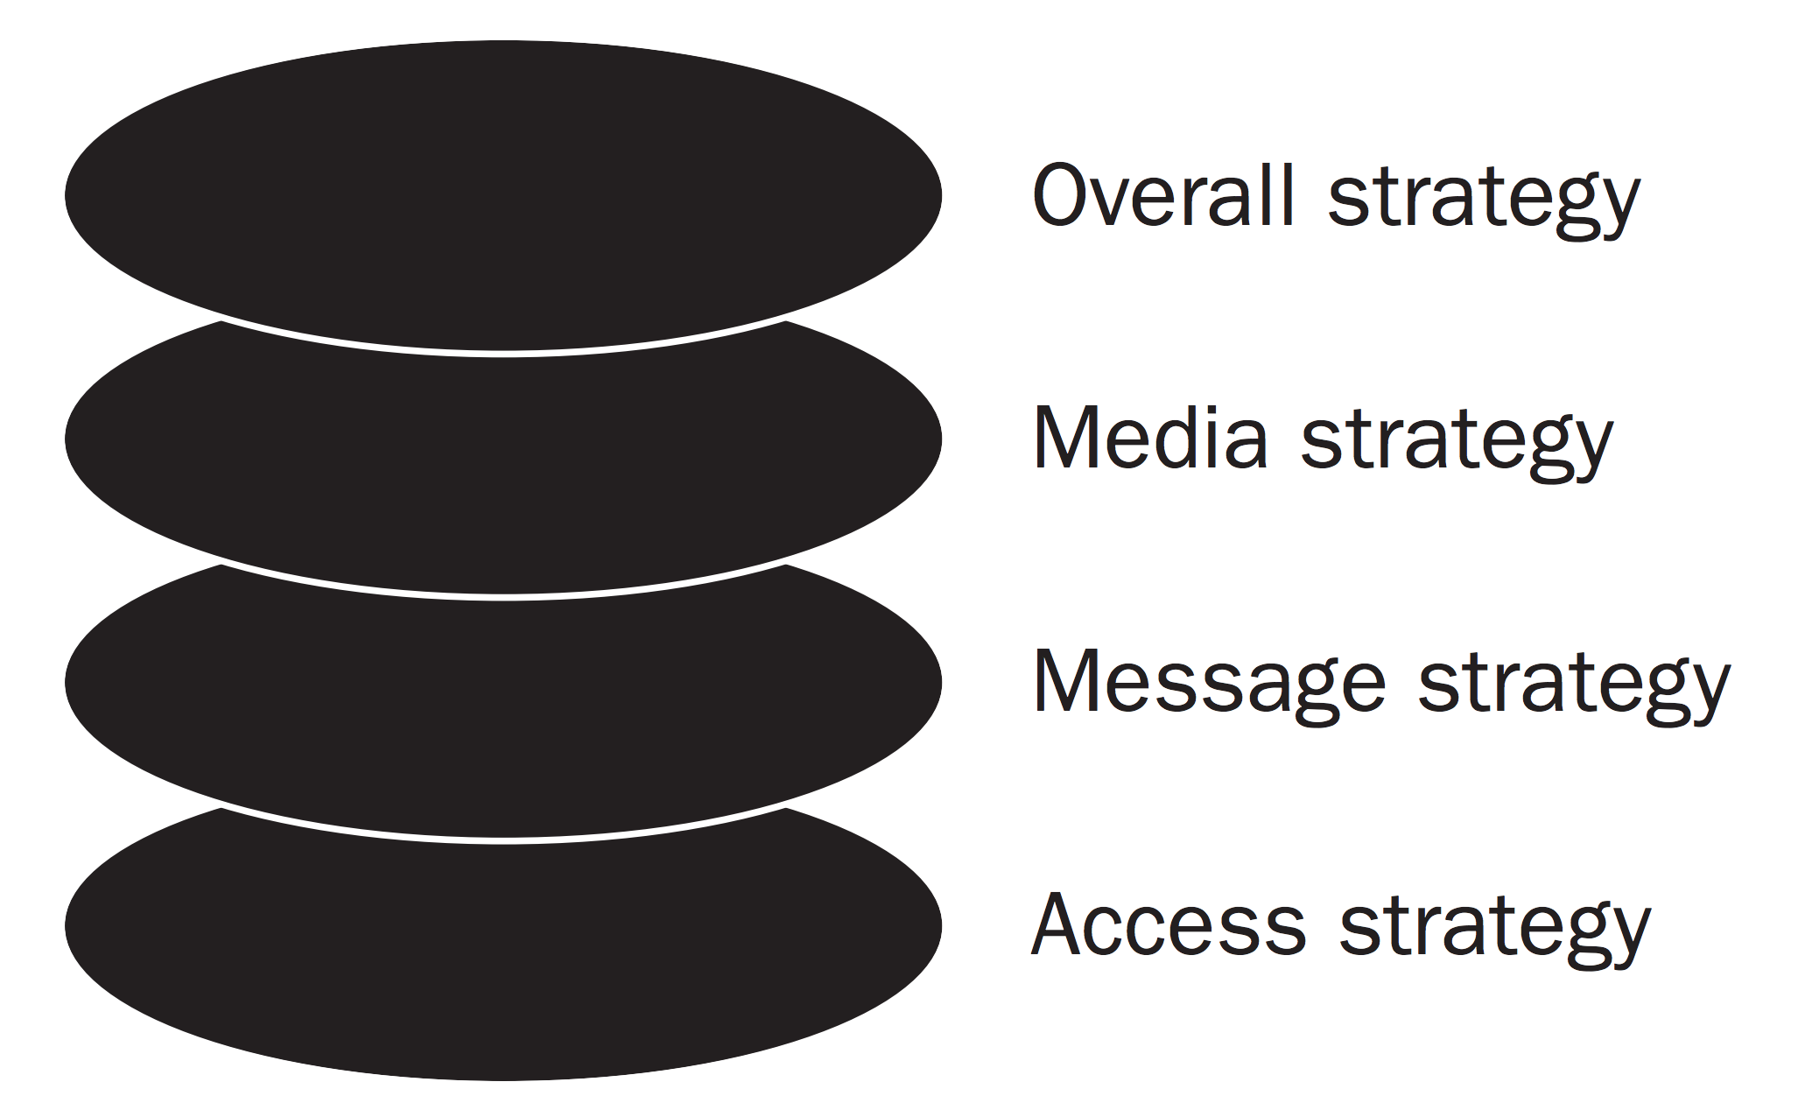
The Layers of Strategy
Notes:
AN OVERVIEW OF THE LAYERS OF STRATEGY
BMSG has developed a short tool called the Layers of Strategy to help groups identify their overall strategy and then make decisions about their media, message, and access strategy based on the goals of their overall strategy.
Again, this is because message should never be first or foremost. Rather, before deciding what to say, advocates need to know what they want their targets to do. That involves developing an overall strategy tied to an advocacy campaign’s specific policy goal. Media, message, and access strategies follow. Having a clear overall strategy will make it easier to make decisions about if and how to use the media, which newspapers to pitch to, who are the best messengers, and more.
In thinking about collecting and using stories, the overall strategy will help us decide who we need stories from, how many we need, why and how we will use them, and how we can support storytellers.
For example, if we are trying to support a local resolution denouncing the public charge rule, an op-ed in a local newspaper with one or two strong stories might be all we need.
If we are trying to quantify the impacts to provide to elected officials, we may still be able to use data on drops in enrollment and couple this with a few stories.
With clinics, health centers, and health departments stretched, the clearer we get on our strategy, the more efficient we can be in using our resources to collect and share stories.
[Facilitators—if you would like to download a one-page handout on the Layers of Strategy for participants, it is available here: Layers of strategy http://www.bmsg.org/wp-content/uploads/2007/01/bmsg_layers_of_strategy.pdf]

Slide 9

Overall strategy
Define the problem you want to address
Clarify the solution you propose
Identify the target with the power to support your solution
Think of allies who can support you
Identify what actions you’ll take
Notes:
DEVELOPING YOUR OVERALL STRATEGY
The first step in developing an overall strategy is clearly articulating the problem you want to address. In working on the public charge rule, there may be multiple problem areas, which means you may have various overall strategies. For example, one problem might be that clients are afraid to use services. Another may be that local elected officials have yet to make a strong statement opposing the proposed expansion of the public charge rule. How you define the problem will determine what solutions you focus on.
Once you know what problem you are going to focus on, it’s critical to clarify the solution you are seeking. Is it asking local elected officials to condemn the proposed public charge rule changes? If you are more focused letting potential clients know about the best way to safely access services, then the solution may be more related to ensuring that community members receive accurate information.
In media advocacy, the target will be the decision-makers who have the power to make the change you want to see. This may be city council, the Board of Supervisors, the state legislature, the Department of Homeland Security, or it could be outside of government, such as getting hospital administrators to make a statement on the public charge rule.
A key part of advancing your communications work is thinking about which allies you need to work with to make your case. The Protecting Immigration Families (PIF) coalition is already doing a lot of this work by connecting allies in California and across the country. Are there others that you need to work with based on your problem, solution, and target? Are there groups not involved in PIF yet that could be strong allies or spokespeople to the media? Maybe a prominent medical professional or community organizer.
The actions you take to influence the target may or may not include the media. This could include in person visits to elected officials, testifying, sending letters, making phone calls, organizing rallies and public events, contacting journalists to get news coverage, releasing reports or statements, writing op-eds, and much more.
[Facilitators—if you have time, you can download the Layers of Strategy and have small groups work through their Overall Strategy related to Public Charge: Layers of strategy http://www.bmsg.org/wp-content/uploads/2007/01/bmsg_layers_of_strategy.pdf.]

Slide 10

Why your overall strategy matters
“A service provider in California said, ‘It’s also because of the news they hear. One family disclosed that they didn’t apply for WIC because they heard that immigration would come to their door.’”
https://protectingimmigrantfamilies.org/wp-content/uploads/2019/04/PIF-Documenting-Harm-Fact-Sheet-Final-4.18.19.pdf
Notes:
WHY YOUR OVERALL STRATEGY MATTERS
Your overall strategy will help you determine what stories you want to collect or share. For example, if you are trying to highlight the health harms to our communities in a presentation to policymakers, you will want to collect compelling stories that can provide a human face to the issue. You might couple this with quantitative data, as well as a call for the policymakers to support the solution you are proposing.
Here is a compelling example from the Protecting Immigrant Families coalition. The entire factsheet weaves together data and stories.

Slide 11


Why your overall strategy matters
Notes:
WHY YOUR OVERALL STRATEGY MATTERS
Or, based on your overall strategy, you may be working to both mobilize people to speak out against the expansion of the public charge rule and to address the fear communities are feeling. Showing immigrants and community members rising up, taking action, claiming their power, and building the world they want to live in is a powerful story that provides a counter to the fear that other stories are creating.
Both of these stories, and the many others we can tell related to public charge, and more broadly, immigrant rights, are powerful and needed. But our overall strategy will help us decide which stories we want to use in the specific context we are working in.
It’s important to note, we may not all agree about which stories are most powerful and aligned with our overall strategy. As much as possible, building in time for these important discussions, and thinking about who is a part of the discussion, is critical. This includes ensuring the immigrants are centered in all of our strategy and storytelling work.

Slide 12

Media strategy
Identify the best methods to communicate with your target
Decide if engaging with the media will advance your goals
Fine the media that will reach your targets
Compile the media tactics you will use
Notes:
DEVELOPING YOUR MEDIA STRATEGY
Once you have your overall strategy, you can move on to your media strategy.
Based on your overall strategy, you will need to decide the best methods to communicate with your target. Your group will need to decide if engaging the media will advance your goals. It may more important to spend your limited time meeting with community groups, or engaging elected officials in one-on-one meetings. If a legislator is supportive, a meeting may suffice, or you may want to use media to support an elected official who is a champion. If you are a service provider seeking to communicate with clients, community meetings or working with immigrant rights’ groups who are well-connected to immigrant communities may be an important first step before considering if you need to engage media. You will want to consider how media attention on immigration issues could impact your organization and the people you serve or partner with, and it may be that you decide not to use media at this point.
If you do decide to try to use media to advance your work, your overall strategy will help you decide what media outlets are more important for reaching your targets. Local media can be helpful with local elected officials, while in California, state legislators may pay more attention to the Sacramento Bee, which often covers state policy, or the local news in their jurisdiction. If you are trying to reach clients, reaching ethnic media in various languages will be important. Don’t forget to think about TV and radio outlets as well!
Finally, what media tactics will help you get your issue in the news, especially when there are many competing stories? In Alameda County, Supervisor Wilma Chan, the local health officer, and a woman who is an immigrant, held a press conference that focused on reaching ethnic media with the goal of letting immigrants know that local leaders value all community members and would be working to ensure immigrants have the opportunity to be safe and healthy. You can learn more about their process here: http://www.bmsg.org/resources/events/immigration-a-dialogue-with-alameda-county-public-health-department/

Slide 13
Media tactics
Creating news
Piggyback on breaking news
Editorials and op-eds
Letters to the editor
Paid advertisement
Notes:
MORE INFORMATION ON MEDIA TACTICS
[Facilitators—please note, this is one area where there are many more resources on the BMSG webpage that you can use as activities in the training or encourage participants to use.]
This is not a comprehensive list, but these are just some media tactics.
Media tactics might be reactive—meaning we react to stories after they are out, such as writing a letter to the editor commenting on a story or contacting a journalist and asking them to correct inaccurate stories on public charge. Or media tactics can be proactive—releasing a report or creating a press event with that includes compelling visuals, spokespeople, creative actions, and more. [See http://www.bmsg.org/about-us/our-services/media-advocacy-training/using-proactive-and-reactive-media-strategies/]
Creating news: Every day editors make decisions about what appears in the news. To elevate your work on public charge, you will have create news. This could include releasing reports, organizing rallies, pitching a story to a reporter, supporting youth-led events, and more. You can use this worksheet on the Elements of Newsworthiness to help create news: http://www.bmsg.org/wp-content/uploads/2015/10/bmsg_newsworthy_elements.pdf
Piggybacking on breaking news: When you look at the daily news, you can think about how to connect public charge to any issue in the news. For example, if there’s an article on a new report on breast cancer, you can respond with a letter to the editor about how the public charge rule expansion could be detrimental to woman’s cancer screenings for immigrants.
Op-eds are longer than letters to the editor and may be proactive or reactive. [For more tips, see both http://www.bmsg.org/blog/getting-your-op-ed-published-lessons-from-a-media-advocate/ and http://www.bmsg.org/wp-content/uploads/2017/09/tce-bmsg-c4c-mod4-creating-news.pdf pages 58-62 and 94)
Letters to the editor can react to or piggyback on other issues. You can have the main components of your letter ready to go and then tailor them to specific news stories to make them timely. Try to respond the day a news article appears. You can create letter to the editor events where you help multiple people write letters—the more the news outlet receives, the more likely they will print one. [More tips here: http://www.bmsg.org/resources/publications/tips-for-writing-effective-letters-to-the-editor/]
Paid advertisements might be helpful for news outlets that you think will reach clients. Or if an important vote is coming up, paid advertisements in the news outlets your targets read, view, or listen to can be one way to ensure they hear your message. Paid advertisements on social media might also be one way to reach your target audience.

Slide 14
Working with the media
Decide whether or not engaging the media will advance your overall strategy
What are your organization’s guidelines about media?
Does your organization have the capacity to support messengers in using their stories in the media?
Notes:
CONSIDERATIONS FOR WORKING WITH THE MEDIA
Media includes thinking about news media, social media, radio, etc.
If you are collecting stories or preparing spokespeople to speak to the media, there are important considerations you must discuss before moving forward.
Ideally, people will tell their own stories and serve as authentic voices but there are safety/logistical concerns that we need to think about from beginning.
Do you want media attention on this issue? And on the people in the stories? Will using the media help you achieve your overall strategy?
Does your organization have guidelines about speaking to the media? Make sure you know who can represent the organization as a spokesperson. Is your organization prepared to have a media spotlight on it and the services it provides?
Does your organization have the capacity to support people in speaking to the media? This may include having staff who can sit in on the interviews, including partnering with legal aid staff who can be present in case the reporters ask about legally sensitive matters. This also includes preparing story tellers for hard questions, setting boundaries, practicing answers to support these boundaries (e.g. I see why you are asking that question, but at this point, I cannot answer it), and preparing story tellers for the negative comments that may appear in online articles.
What other ethical considerations do you think your organization needs to discuss before connecting the media to clients?

Slide 15
Working with reporters
We cannot control or guarantee how reporters will cover our issue or interviews
However, we can:
  Track reporters, follow on social media, and develop relationships
  Contact reporters—especially when they do a good job!
  Say no to interview requests if it doesn’t further overall strategy
  Provide journalists with the resources and story elements they need to tell stories
  Know our boundaries before speaking with reporters!
Notes:
WORKING WITH REPORTERS
It’s important to note, there are no guarantees in working with the media and advocates cannot control the stories that are printed or the questions the reporter asks, even if you set expectations beforehand. But there are things we can do to be as strategic and prepared as possible.
Tracking reporters and developing relationships with those reporters who do a good job reporting on immigration, health, and/or public charge. This might include following them on social media, sending them pitches, or writing them an email when they publish a good article. The Protecting Immigrant Families (PIF) coalition often puts out news stories on public charge—you can use these, or set up Google Alerts on public charge, to track reporters covering the issue, or more broadly, covering immigration or health.
It’s always okay to say no to an interview, especially if the reporter has written articles that are inaccurate or do not advance your overall strategy. If a reporter calls and you are not familiar with them, you can ask what their deadline is and say you need to call them back, and then research what they have written and make a decision about whether agreeing to an interview with them will advance your overall strategy.
Reporters work on tight deadlines. Factsheets, handouts with Frequently Asked Questions, or lists of spokespeople ready to talk to reporters, can help them report on public charge. PIF already has many of these resources on their website.
If you are preparing spokespeople to talk to the media, it’s critical to think about and plan for safety of sensitive sources. Immigrants, mixed-status families, and service providers who work with immigrants need to think about if and how they want to interact with the media and what will help establish safety and ask for it before meeting with reporters. Social and health service organizations can collect stories without identifying information and pair the stories with quantitative data, research, and calls for solutions if individuals are uncomfortable speaking to the media directly. See the storytelling module for more information.
It is helpful to discuss boundaries beforehand with the messenger and the reporter. For example, there may be some areas of a personal story that a messenger is not comfortable talking about. You can help them practice what they will say to the reporter, such as “I can see why you are asking that question, but I’m not comfortable answering it.” Setting expectations with the media from the beginning, such as noting that messengers don’t want to use their full name or have their photo taken, state their immigration status, or only want to speak to the media if another member of your organization is present, are all things you can ask for.
[Facilitators-–if participants want more information on the elements of newsworthiness and building relationships with reporters, this is a helpful webinar http://www.bmsg.org/resources/events/webinar-elements-of-newsworthiness-and-developing-relationships-with-reporters/]

Slide 16
Message is next
You got media attention, now what?
Notes:
WHAT’S NEXT? DEVELOPING YOUR MESSAGE
If you have been developing and overall strategy and have a clear media strategy, at this point, you may be almost ready to pitch a story to a reporter, write an op-ed, or respond to a reporter’s call.
But what do you want to say?

Slide 17

Message strategy
Target: who we want to hear it
Message: what we say (story)
Messenger: who says it (storyteller)
Notes:
MESSAGE STRATEGY
Our next layer in the Layers of Strategy is Message Strategy. This includes:
Target: remember to go back to your Overall Strategy and clarify who we want to hear our message AND keep in mind what we want them to do after they hear our message
Message: includes what we say, the length of the message (shorter is almost always better in working with the media!), and whether verbal or written
Messenger: who conveys the message

Slide 18
Message development
Components of a message
Statement of problem
  What’s wrong?
Value dimension
  Why does it matter?
Policy solution
  Who should do what by when?
Notes:
MESSAGE DEVELOPMENT
[Facilitators—this is a KEY concept and helping people build their capacity to communicate with effective messages is an area you want to spend time within the training. People can use this skill in multiple ways—from talking to a funding agency, to delivering testimony at city council, to crafting more engaging PowerPoint talking points. Keep this slide in the presentation, even when time is short. This is a handout you can print that helps participants develop their messages: http://www.bmsg.org/wp-content/uploads/2015/10/bmsg_message_development_worksheet.pdf]
An effective advocacy message has to include these components:
A clear and concise problem statement
An appeal to shared values, what is at stake?
A call for concrete action = the more specific the better
You do not need to develop messages in this order, but your messages should include all 3 parts. You can weave values into your problem and solution statements. In an interview, you can use this formula over and over to answer each question.
We know that advocates generally spend more time talking about the problem than the solution. We need to flip this—try to spend more time on the solutions and values. These are highlighted less often in the media, but are the most engaging parts of the message.
Values are what’s in our hearts. For many of us, we aren’t used to speaking about these deeply held values at work, but they are something that often are shared within our community. Examples of values include: unity, democracy, interconnectedness, people power, justice, dignity, innovation, or pride of place (e.g. Our town has always overcome obstacles, and we can come together to fight this!). You do not need to use these specific words, but your message should evoke values.
Your solution comes right from your overall strategy. You may need to work on making it easier to understand and avoiding jargon, but at this point, you should already know what solution you are demanding.
As you are collecting, creating, and sharing stories, you can ask: does this story transmit your message?
Stories should include some context about the problem we are facing. However, stories often focus exclusively on the problem, which can help people emotionally connect to the story, but does not fully advance our Overall Strategy. To strategically use stories to advance change, we need to connect these problems to values and solutions.
Stories can allow us to lead with values. For example, a story may include the value of interconnectedness, such as what happens to our whole community when a neighbor or friend is afraid, or a story may focus on the value of unity, like the photo of May Day where we see a unified movement of people using their power. You can build stories that focus on values by asking why this issue matters, why it’s important to you or those you are collecting stories from, and why others should care.
Stories should also connect to a solution. What needs to be done? This is an opportunity to tie a story to collective action—on policy, on being a welcoming or sanctuary city or county, on continuing to provide services to all, on using people power to call for immigrant rights.
How will you connect your story to values and solutions? Or train messengers to tie their stories to values and solutions? Or if you are collecting stories to use them in advocacy, how will make sure to tie them to values and solutions in talking points, presentations, social media posts, or other materials?

Slide 19

Frames are mental pathways that help people understand the world.
Notes:
FRAMING
Framing is a part of your message.
There are no blank slates. All people take in new information with ideas, or conceptual frames, already in their heads about the way the world works.
Without even knowing it, we use frames to categorize information, identify patterns, and derive meaning from them.
Frames matter because they can foster certain understandings and hinder others. Once activated, frames trigger emotions, associations, values, judgments, and causal explanations.
Frames don’t just exist in our minds. They also exist in how we talk about issues and how the news covers issues.

Slide 20

How are stories framed?
Portrait stories tell us a lot about the individual but much less about what surrounds them.
Landscape stories show more of the environment around the person, including the systems and structures that surround them.
Notes:
HOW ARE STORIES FRAMED?
One way to think of news frames is to think of the difference between a portrait and a landscape.
In a story framed as a portrait, audiences learn a great deal about an individual characters in a story, like a person who is afraid to use clinic services. A landscape story, on the other hand, brings in the scene, other actors, a plot, history, context, or even data. Sometimes the characters in a landscape story will be immigrants and their families that are hurt by the public charge rule; sometimes it will be the healthcare providers who are hurt because they can’t do their job of healing and helping. Sometimes the characters will be the decision-makers who are putting politics over health, using racism and anti-immigrant sentiment to for political gain, and scapegoating children and families even when it jeopardizes the health of our communities and country.
Another example of a portrait story that makes it challenging bring in collective solutions is the “hero story” where one person overcomes a challenge. We see a lot of these in the news—one person navigates the immigration system or overcomes early childhood hardships to thrive in the U.S. These portrait stories place responsibility for the problem and solution with individuals and imply that anyone who doesn’t ”make it” has failed because of personal failings. We can have strong characters in a landscape story, such as a community organizer leading a rally, but the context and landscape broaden the responsibility for the problem and solution to collective responsibility.
Research shows that stories that are framed as portraits will invoke solutions that focus on personal responsibility. However, when people who see news stories that have been framed more broadly -- like landscapes – they are more likely to recognize solutions that do not focus exclusively on individuals, and their ideas for solutions will focus on community responsibility – or the policies and institutions that shape the conditions around people.
BMSG has developed online resources that goes deeper into framing. http://www.bmsg.org/resources/framing-101/ and http://www.bmsg.org/resources/publications/communicating-for-change-shaping-public-debate-with-framing-and-messages/

Slide 21
Who are effective messengers and storytellers?
Your overall strategy will shape who is an important messenger
Authentic voices
Able to illustrate landscape
Willing and ready to tell their story
Connect to community organizing groups
Notes:
EFFECTIVE MESSENGERS & STORYTELLERS
Your overall strategy will help you decide who are potential messengers.
A key part of powerful messages is who is delivering them. When immigrants share stories of resiliency and using their power to support their families, create change, and work towards a healthier society for everyone, it can reduce fear and help advance movements for justice.
Anyone can harness their authentic voice and speak from their heart about public charge and health. Clinic staff or social service and health professionals can tell stories of what it is like to help clients navigate the system; physicians can tell stories of how fear of coming in to the clinic impacts treatment plan; mental health providers can talk about the added stress they are seeing in their clients.
If messengers are talking to reporters, they should be able to connect their portrait story to the landscape story. Training and coaching can help with this, along with writing out and practicing with the message development questions.
If clinics or organizations are collecting stories, they can weave them into materials that include the landscape, values, and solutions. This puts less pressure on spokespeople to be able to connect their personal story with the landscape and allows the clinic or organization to have more control over how stories are portrayed, such as whether real names are used.
Messengers must be willing and ready emotionally to share their stories. What support can your organization provide messengers in sharing their stories? This might include working through the tools in this module, anticipating tough questions from reporters, reminding messengers that article comments may include racist and xenophobic comments and asking if they are prepared for that. It could also include following up with messengers after stories are printed or aired to see if they need additional support, and/or connecting messengers with organizations focused on community organizing — they often help the communities they work with build their political and communications skills and may already have experience at navigating working with the media.

Slide 22
Alternative messengers
Aggregate stories
Staff stories
Use stories from comments submitted to the Department of Homeland Security
Use Protecting Immigrant Family (PIF) resources
Use institutions as characters in stories
Notes:
ALTERNATIVES TO CLIENT STORIES
To protect clients, you can avoid sharing specific or identifying stories and tell more of an aggregate story, such as: “We are hearing from many clients who are still eligible for services that they are afraid to come in and for many, this is leading to health issues, such as...”
If your organization does not have the capacity to support clients in sharing their stories, your staff can be valuable story tellers. As long as they don’t include identifying information, they may be able to share very compelling stories—such as working with clients who were making great progress in addressing a health issue, but have now quit coming to appointments. With limited capacity, it can be easier to ask your own staff to fill out a survey or be interviewed, and if you have questions, it’s easier to track down staff. Plus, you have more opportunities to train staff to share their stories.
There are many compelling stories in the comments that people submitted to the Department of Homeland Security on the proposed public charge rule. You can search these public comments and pull out stories that exemplify the points you want to make based on your Overall Strategy. [ADD LINK TO COMMENT}
PIF has compiled other resources like the factsheet in this presentation and is also pulling together factsheets based on the comments to the Department of Homeland Security. You can always localize the issue by adding local data or information, but use stories from PIF materials as examples, noting that they are not from your organization but illustrate the issue. https://protectingimmigrantfamilies.org/analysis-research/
Finally, in telling a story, the characters don’t have to be individual people. Your organization, coalition, or city can be a character in the story, especially stories about how organizations are working to ensure that everyone has the opportunity to be healthy.

Slide 23
Who is your audience?
Tie it back to your overall strategy
What do you want your audience to think or feel, and ultimately do, after they hear the story?
How will you reach your audience?
Notes:
WHO IS YOUR AUDIENCE?
Your overall strategy will inform your decisions about who your audience is, whether it’s elected officials or residents in your neighborhood.
You can ask yourself what you want you want your audience to think or feel, and ultimately do after they hear the story?
And how will you reach your audience? The Media Module provides information on reaching your target audience.
Keeping your audience in mind as you plan is an important aspect of using stories effectively to advance change.

Slide 24
Media advocacy summary
Use the Layers of Strategy
Start with your Overall Strategy
Build in time for developing a strong media strategy
Make sure messages name the problem, emphasize the solution, and lead with values
Move from the portrait to the landscape
Notes:
MEDIA ADVOCACY SUMMARY
This is a summary of the main themes of the first part of this module.

Slide 25
Story Telling on Public Charge
Notes:
This is a transition slide to show what part of the presentation you are focused on

Slide 26
The power of stories
“If you can write a nation’s stories you needn’t worry about who makes its laws.”
-- George Gerbner, 1987
Notes:
THE POWER OF STORIES
Before we get started, why do you think stories are important to our work?
[Facilitator’s note—take a few answers to encourage participation and hear people’s thoughts. Many will likely align with the ideas in the module and you can note that, as well as the fact that there is a lot of wisdom in the room and we all are storytellers with stories to share in some way].
Stories can be very powerful. Our minds are wired to tune into stories much more than data. Stories can touch our hearts, help us build empathy, and ideally, move us to action.
We know there are so many stories out there about harmful immigration policies. It’s critical to share these stories, but we need to ensure we plan ahead so we consider all the ethical implications for collecting and sharing stories. And ideally, we are supporting people to share their own stories in the way that feels most comfortable to them.

Slide 27
Working with messengers
What capacity do we have to collect and share stories and support storytellers?
What format will work best for collecting stories?
What questions will we ask to align with our overall strategy?
How can we protect data/stories to ensure privacy?
Notes:
WORKING WITH MESSENGERS
Does your organization or coalition have the capacity to train messengers if they will be speaking to the media or testifying? This can include helping them tie their stories to the landscape and solutions if they will be speaking to the media or policymakers.
If you don’t have the capacity to train messengers, you may decide to collect stories from clients or residents. Does your organization have the time and capacity to build the rapport and trust needed to interview clients? If you ask for stories about the impacts of the public charge rule, those you are asking may want to know more about the rule. Do you have resources and staff available to meet their needs? If you cannot answer questions they have or provide resources, it may be best to find another way to integrate stories into your communication. As social service or public health providers, if we bring up challenging issues with clients, we need to be prepared to answer their questions and provide support. If you provide direct services, do you have the capacity and relationships to connect clients who share their stories to community organizing groups? For example, if someone shares their story about how the proposed public charge rule is impacting them and wants to get more involved in organizing to support immigrant rights, will you be able to help them to connect to another organization? Do you have the capacity to train staff who are collecting the stories? Asking someone their story can be a very personal experience—people may share information about trauma, fear, or actions they are taking to push for change. Story collectors need to be sensitive to these issues and also have space to process their own emotions—hearing many stories of trauma and fear can also impact staff.
Will you conduct interviews? Surveys? Have an online submission tool? Do you need an interview guide to help story collectors in focusing on questions that are driven by the overall strategy, are ethically sound, and are concise enough to fit into a client visit? What training will you need to give to help story collectors use this tool?
The questions you ask will be driven by your overall strategy. If you want to collect stories about the negative impacts of the proposed rule, you will need to ask about the impacts. If you want to collect stories of resistance, you will need questions that ask about that.
Where will you store the stories? How will you ensure privacy and safety? Can you collect stories without using any identifying information? Can you anticipate any ways that sharing stories about your clients may jeopardize their safety?

Slide 28
Working with messengers
Minimize the amount of participant information collected
  You may not need more than a first name and contact info to provide reminders
  If providing incentives, use a gift card and hand out at interview/focus group
Use pseudonyms when reporting results
Maintain confidentiality of any participant’s information
Consider destroying participant information after collecting stories
Consider destroying recordings once they are transcribed or the report is completed
  From Protecting Immigrant Families webinar on “How Community-Based Organizations Can Help Document the Chilling Effects from the Public Charge Regulation”
Notes:
WORKING WITH MESSENGERS
The national PIF network had a webinar on How Community-Based Organizations Can Help Document the Chilling Effects from the Proposed Public Charge Regulation. https://www.youtube.com/watch?v=VZmj7_zGV4I&feature=youtu.be
These are their recommendations for working with messengers and addressing some concerns around collecting client stories.

Slide 29
Storytelling summary
Start with the Layers of Strategy
Use stories with values, solutions, and that connect to the landscape
Assess your capacity to collect and share stories and/or support messengers and tailor your approach to your capacity
Notes:
STORY TELLING SUMMARY
This is a summary of the main themes of the storytelling portion.

Slide 30
Tips for communicating about public charge
Notes:
This is a transition slide to show what part of the presentation you are focused on

Slide 31
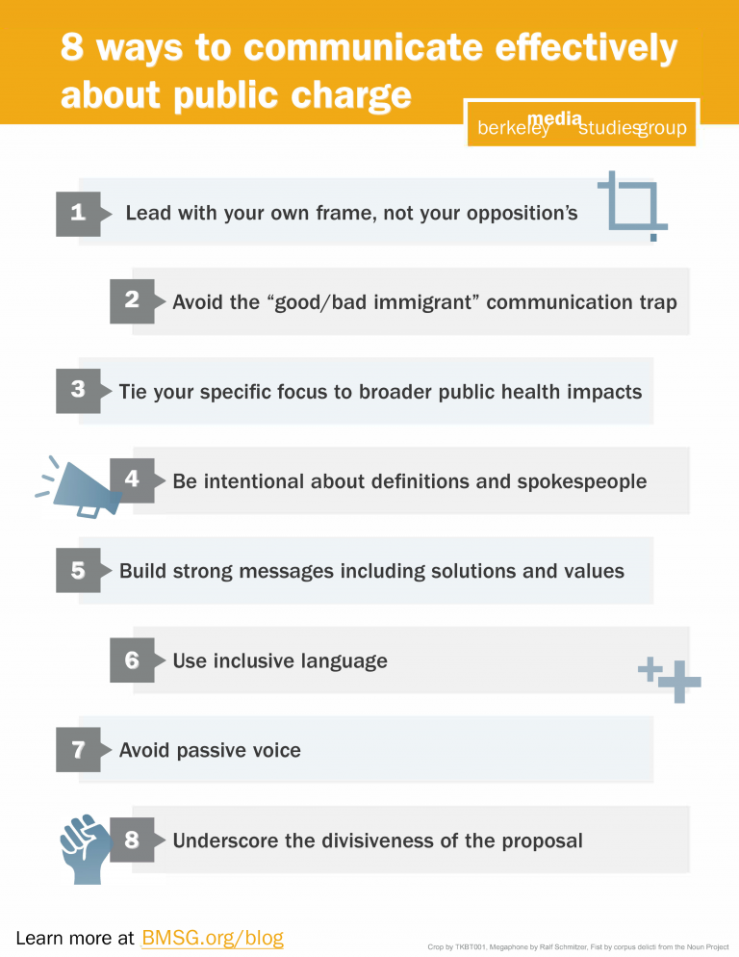
http://www.bmsg.org/blog/immigration-public-charge-strategic-communication-tips/
Notes:
COMMUNICATING ABOUT PUBLIC CHARGE
Next, BMSG has 8 tips on communicating effectively about public charge.
You can read more about these tips here: http://www.bmsg.org/blog/immigration-public-charge-strategic-communication-tips/

Slide 32
1) Lead with your own frame, not your opposition’s
Use “public charge test” or “public charge regulation” rather than labeling people as public charges
Use the term once and move on
Watch for terms that set you up to reinforce the counter frame:
  “This is not . . .”
  “We are not . . .”
  “We don’t intend to _______, rather _______”
  “Data actually show that . . .”
Notes:
LEAD WITH YOUR OWN FRAME, NOT YOUR OPPOSITION’S
This connects back to the first part of the module and the discussion on framing.
Often when we are rebutting ideas, we end up using the opposition’s words and frames in our rebuttal. For example, in showing the immigrants pay taxes and use fewer services, we’ve seen advocates use the opposition’s frame (e.g. Immigrants are NOT a drain on the system!). We know from framing research that even if you are rebutting the opposition, using their language triggers the opposition’s frame and in this example, uses the same dehumanizing language. This example inadvertently primes people to think about immigrants as a drain on the system.
Public charge itself is a dehumanizing term. Use it once and move on and focus on it as a rule or regulation. When we label people as a thing, like a public charge, it’s dehumanizing.
Watch for words that show you are about to step into the opposition’s frame.
Focus your messages and any responses to questions on your message, your frame, why this issue matter to you, and what you envision as the solution. Practice using the Message Development Strategy from the first part of this module so you can always stay in your message.

Slide 33
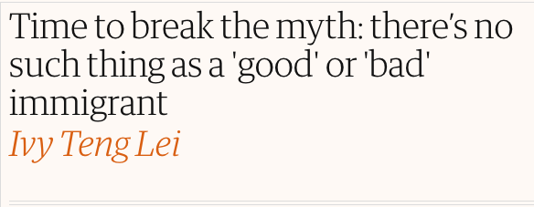
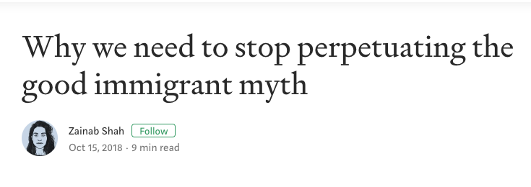
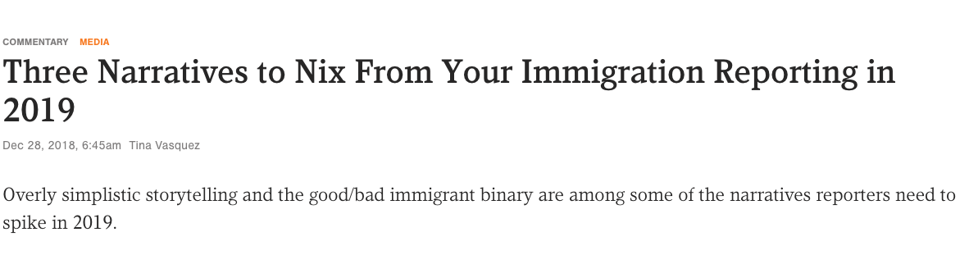
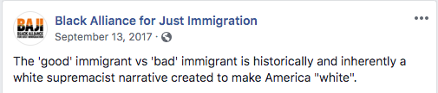
2) Avoid the ”good/bad immigrant” communication trap
Notes:
AVOID THE GOOD/BAD IMMIGRANT TRAP
People come to the United States in many ways, under many circumstances, and for many reasons. However, we still see people communicating about the public charge test in a way that falls into or “deserving/undeserving” language trap (e.g. people who have followed all the rules).
This important recommendation comes directly from immigrant rights group. In some news articles or organizational statements around public charge, we’ve seen advocates use language such as “they’ve done everything right” or “immigrants on the legal path” which triggers thinking about those on the “illegal” path, a frame we do not want to use. Falling into this trap can make the broader fight for justice for all immigrants harder.
If we are focused on the social and public health impacts of immigration policy, we must be concerned with the health and well-being of all immigrants. Using divisive language will only make it more challenging in the long run for public health advocates to describe how current immigration policies are rigged against health and well-being and show why these policies need to change.

Slide 34
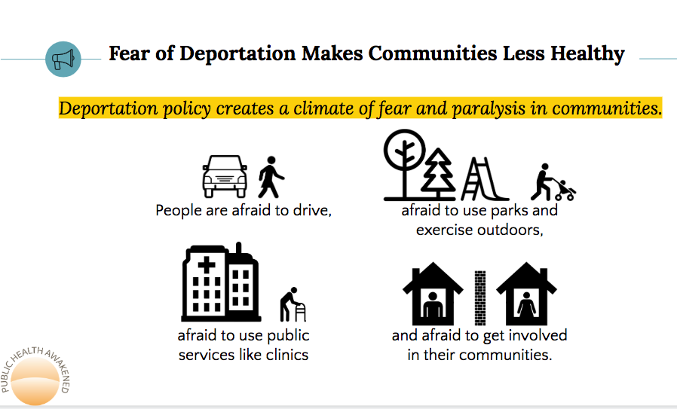
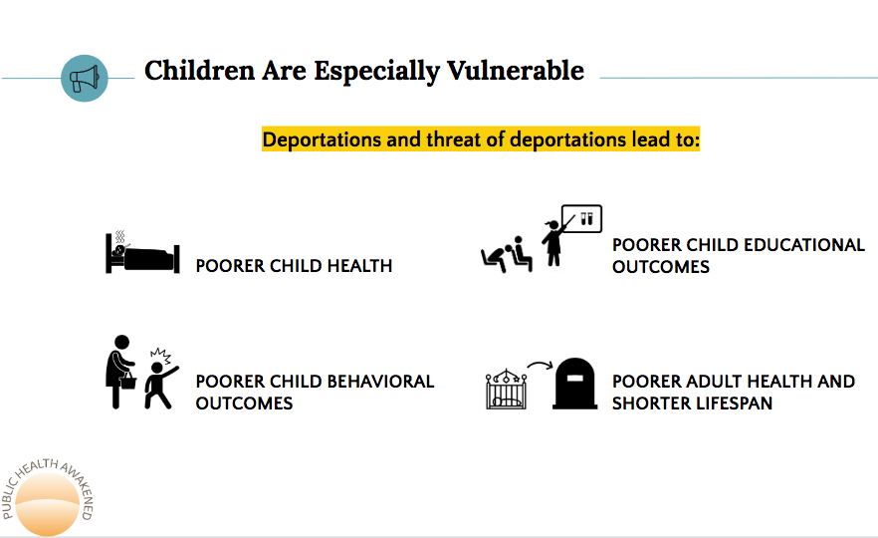
3) Tie your specific focus to broader public health impacts
From Public Health Awakened https://publichealthawakened.com/guide-for-public-health-to-protect-immigrant-rights/
Notes:
TIE YOUR SPECIFIC FOCUS TO BROADER SOCIAL AND PUBLIC HEALTH IMPACTS
When a leaked draft of the proposed changes to the public charge came out, and was then updated, some social services and public health organizations noted that the released version was good news—their specific program was not included. We agree that the more programs that are excluded from the proposed expansion and any final ruling, the better. But public health is holistic and we won’t have truly healthy communities unless we fight for all areas of health.
Social services and public health have a stronger voice when we are unified. When we speak about only one program that the proposed expansion might impact without bringing in the broader context of how the entire rule expansion harms public health, we fall into the trap of working in silos.
We can and should do both: Give examples of how the proposal is detrimental to housing, nutrition, health care, and other specific areas that impact health, and tie this back to the broad need for sound, comprehensive federal policy that prioritizes health, not partisan politics.

Slide 35
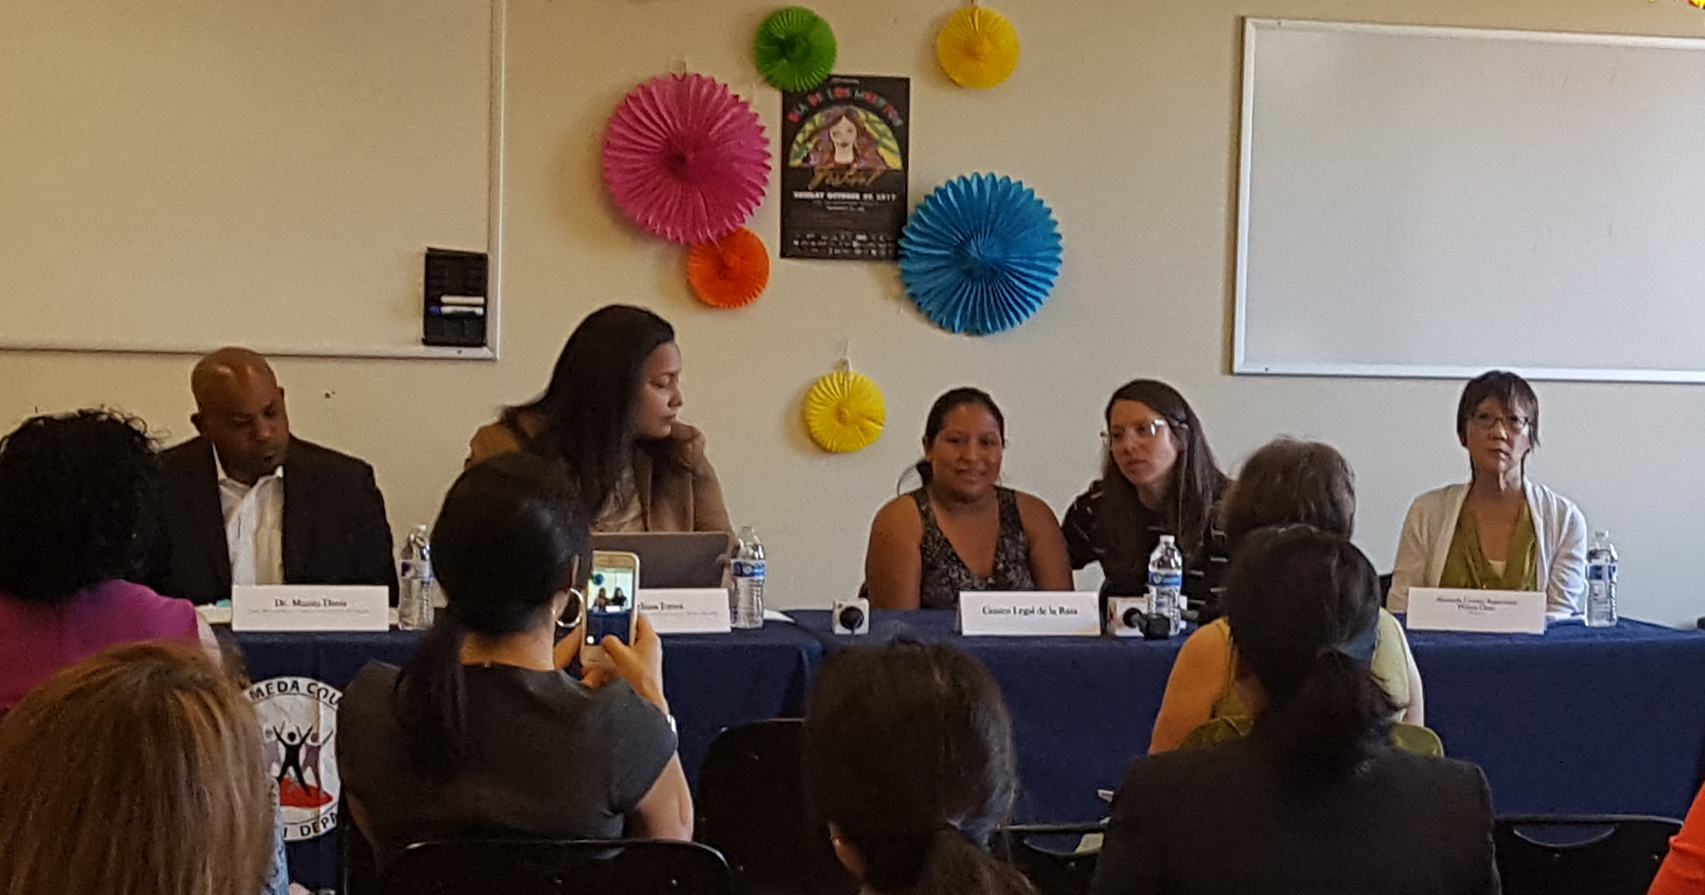
4) Be intentional about definitions and spokespeople
WHAT IS PUBLIC CHARGE?
The current administration seeks to expand the public charge test so that it includes additional and essential health, nutrition, and housing programs.
-Berkeley Media Studies Group
Alameda County Press Conference
Notes:
BE INTENTIONAL ABOUT DEFINITIONS AND SPOKESPEOPLE
Spokespeople: In both in messages to clients or people who might be fearful of using services and advocacy messages, having immigrant voices at the forefront is critical.
Alameda County, CA wanted to reach community members to let them know that elected leaders and the public health department value immigrants and that people should continue to use needed county social and health services. Supervisor Wilma Chan spoke of her family’s immigration experience. A resident facing landlord harassment spoke with her legal representative about how she realized she could fight back and had a right to be safe in her apartment. The Alameda County Health Officer spoke of the public health impacts of both rhetoric and policy. This is a good example of the types of spokespeople who are effective messengers about public charge. When BMSG has analyzed the news, unfortunately, they have seen fewer public health and immigrant voices in news stories about immigration. If we can increase these voices in news coverage, it can show a different side of the story to the public and policymakers. [Facilitators: here are two resources on a news analysis of how immigration is covered in four California counties: http://www.bmsg.org/blog/how-news-coverage-perpetuates-harmful-language-about-immigration/ and http://www.bmsg.org/resources/publications/immigration-in-the-news-an-analysis-of-coverage-from-four-california-counties/)
Definitions: Many news articles and organizational statements have used the Department of Homeland Security’s definition of public charge, even when they are speaking out against it. Their definition and use of the term public charge is dehumanizing—labeling people as public charges rather than talking about the public charge test. We can work to ensure we describe the public charge test in a way that does not label people as public charges, that includes context that shows how the expansion of the rule will harm the health and well-being of our community members and larger society, and is a threat to public health. The public charge test can be hard to define concisely, but we can do it with practice—here is one example.

Slide 36
5) Build strong messages that include solutions and values
All of our communities are connected. Our country is stronger when our neighbors, families, and community members have the opportunity to be healthy.
As a public health worker, I am already seeing how the fear created by the proposed public charge test expansion is impacting the community I live in.
The policy will harm millions by undermining access to essential health, nutrition, and shelter for immigrants and their families.
This is why I’m urging our state to condemn the expansion of the public charge rule.
Values
Problem
Landscape
Solution
Notes:
SAMPLE MESSAGE
Here’s an example of a message that includes the components we talked about earlier—the problem, solution, and values, and ties a personal story from a public health worker to a broader landscape.
Here is a brief sample message to show one way to weave in a personal story. You can see it includes the problem, landscape, values, and solution. You don’t have to include the components in this order and it can be very powerful to lead with values.
This example uses values like interconnectedness, which shows we are stronger together.
The problem includes a personal story of a public health worker, but then this portrait story expands back out to include the landscape and solution.
This is a very short example. If this was part of a letter, testimony, or communications materials for a reporter, the story might include more detail about exactly what the public health worker is seeing in their job, as the PIF handout shows. But you can see that the message can be quite concise and still contain all the parts of a message.

Slide 37

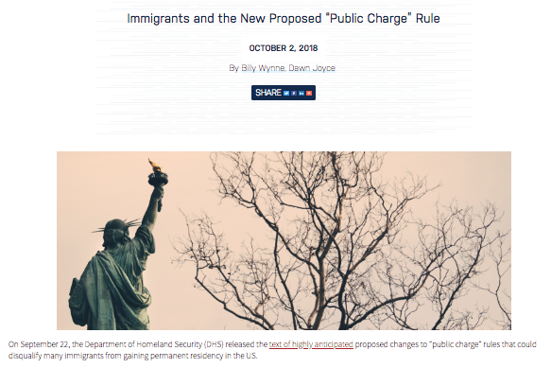
6) Use inclusive language and visuals
Notes:
USE INCLUSIVE LANGUAGE AND VISUALS
Few of us are immune to “otherizing” language creeping into our communication. Challenging the basis for this proposed rule is both an opportunity to strengthen our message and actively work to undo the legacy of racism and oppression that is part of our nation’s history by understanding how it still manifests in our work and language today.
Using terms like “them” often happens in public health reports or statements. Instead, use language that helps show interconnectedness and shared fates (e.g. “We can create a community where everyone can thrive by asking the Department of Homeland Security to withdraw the proposed expansion to the public charge test”).
Watch out for terms like “needy” and “burden,” even if it’s to rebut false claims that immigrants use a disproportionate amount of programs and services. Terms like “alien” and “illegal” are extremely pejorative and should never be used.
And while it’s part of our nation’s history, equating immigrants with the “tired, poor, and huddled masses” can also paint a narrow, one-dimensional view of immigrants that diminishes the great contributions immigrant communities have made — and are making — in the U.S. Instead, use words and images that highlight people recognizing and building their power to create healthy communities. (https://www.raceforward.org/practice/tools/drop-i-word)
On the left, a news story about the public charge test used a visual of a border wall, which symbolizes divisiveness and is otherizing, as well as inaccurate as the public charge rule changes could affect many people already living in the United States. BMSG’s Director saw this and emailed the news organization with her observations, and they changed the picture to the one the right--the Statue of Liberty turning her back on those seeking freedom. This is just a small change, but is an example of a visual that helps us communicate the values we uphold and inclusiveness.

Slide 38
7) Avoid passive voice
The expansion of the public charge was proposed…
The Federal administration proposed expanding the public charge test
Notes:
AVOID PASSIVE VOICE
This is advice that many communications experts have given across a range of issues, but we still see it organizational materials and news stories on public charge, so it’s important to work to change it.
When we use passive voice, we obscure who is (or should be!) taking action, whether it’s a positive action we support or a negative action that we want to stop. Passive voice makes it sound like things just “are” when, in fact, people make them that way, and people can change them.
For example, instead of saying “the expansion of the public charge was proposed” we can say “the federal administration proposed expanding the public charge test.”
Passive voice can also add extra words that you don’t need, so taking it out can help shorten your communications’ materials.

Slide 39
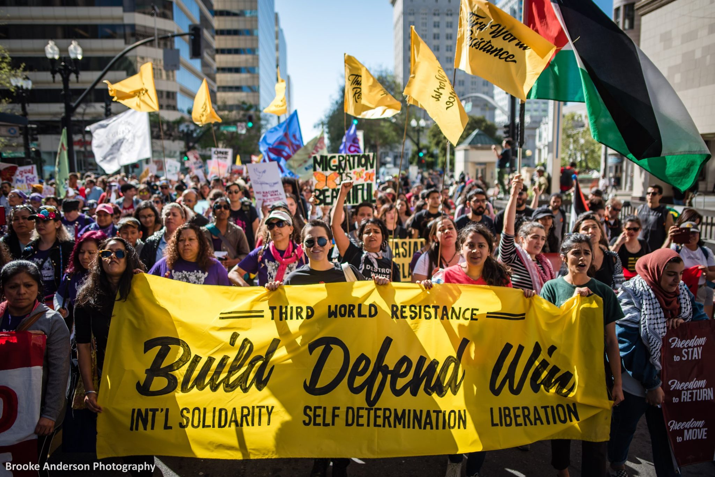
8) Focus on unity & show how the proposal is divisive
Photo by Brooke Anderson, http://www.movementphotographer.com
Notes:
FOCUS ON UNITY AND SHOW HOW THE PROPOSAL IS DEVISIVE
The Race-Class Narrative Project recommends explicitly naming when elected leaders are using race and racism to divide us. Showing people rising up in unity to fight against this division is a powerful to engage people.
When we call out the strategies that use race to divide us, we help people see what they really believe: that unity is the key to healthy, robust communities where everyone can thrive. The administration is using the expansion of the public charge rule as an effort to divide us by making immigrants the “other.” We know better. And we know that we are better — and healthier — together.
Name that this is a tactic of the administration of using race to divide us.
Use the value of unity.
Name that we have come together before and can do so again—that we know better than to be divided by race.
And we know we are better and healthier together.
This might sound like, “We know that the current administration has consistently use race as a tactic to distract and divide us, and they are doing this again with the proposed public charge rule expansion. But we know we are better and healthier together. We’ve come together before as a [organization, city, county, country] to rise above this type of division, and we can do it again by working together to ensure that everyone in our community has access to what they need to be healthy.”
You can visit this website to learn a lot more about why we need to explicitly state that some policies, and policymakers, are trying to use race and class to divide us and offers suggestions to help all of use an effective race-class narrative. https://www.demos.org/race-class-narrative-project
FACILITATORS: we have permission to use this photo from Brooke Anderson. Please keep her name on the slide and do not use the photo without crediting her.

Slide 40

Recommended resource
https://caimmigrant.org/resource/
Notes:
RECOMMENDED RESOURCE
In addition to the resources recommended throughout the presentation, we highly recommend this resource from the California Immigrant Policy Center. It is a communications toolbox for immigrant rights advocates. While the focus is broader than public charge, the resource is full of helpful information and tools. Building time to go through it with your team, coalition, or organization will help you create a solid communications strategy.

Slide 41
THANK YOU!
Prepared by Berkeley Media Studies Group
PHONE: (510) 204-9700
WEBSITE: bmsg.org
TWITTER: @BMSG
FACEBOOK: Berkeley Media Studies Group
Notes:
CONCLUSION
This is an overview of both media advocacy and some specific recommendations we can all use to communicate more effectively about the proposed public charge rule. We hope you will use these tips in conjunction with the other to ensure that all of our community members have the opportunity to be healthy and thrive.
[Facilitators—if you have time, you can have participants work through their Overall Strategy and Message Development worksheets in small groups. As the groups share out, ask the other group members what works in their messages and what could improve. Ask if they are able to hear the solutions and values, and if not, what would make them stronger. Listen for jargon, passive voice, using the opposition’s frame, and other issues from the module. The best way to incorporate all of the material from this module is to practice, which means writing, speaking, listening, revising, and doing it again!]
Please feel free to reach out to Berkeley Media Studies Group with additional thoughts or questions.

